Slide 1
Test environment
IQ Xel/IQ View or Other
DUT
IQ Browser
QA Tool
测试软件无需两台电脑，信号IN/OUT控制软件，都在一台电脑上面操作

Slide 2
Test environment
Install WinPcap_4_1_2.exe before Run QA Tool

Slide 3
QA Tool process for 2.4G
Click QATool_Dbg.exe

Slide 4
QA Tool process for 2.4G

Slide 5
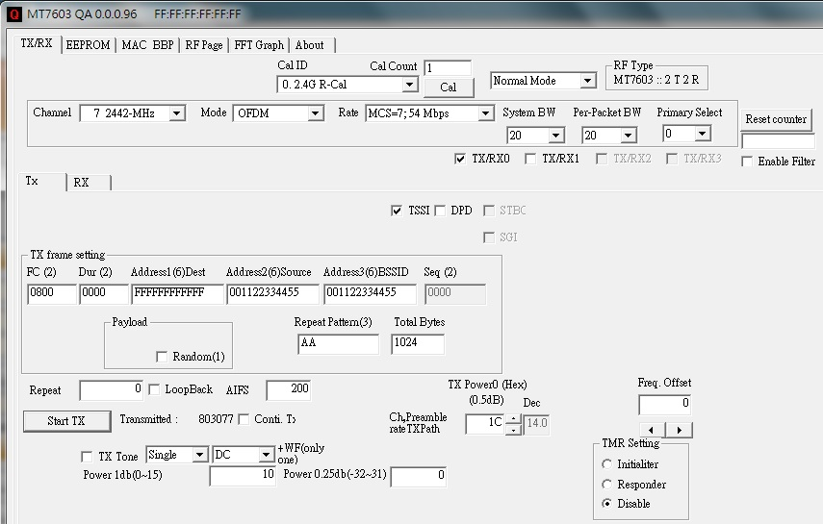
QA Tool process for 2.4G
4
1
2
3
5
1.Select channel
2. Modulation
3. Rate
4. Bandwidth
5. Select ANT port
6. 0 is continuous packet
7. Tx power index
6
7
8

Slide 6
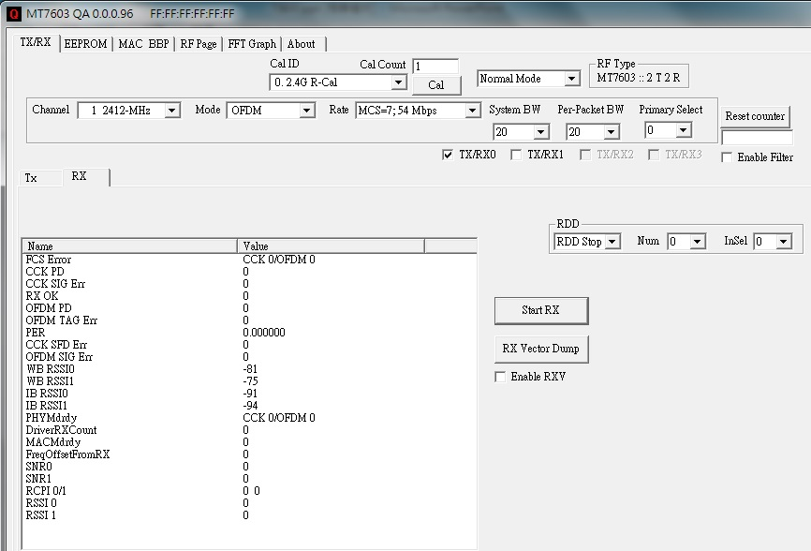
QA Tool process for 2.4G
4
1
2
3
5
6
1.Select channel
2. Modulation
3. Rate
4. Bandwidth
5. Select ANT port

Slide 7
QA Tool process for 5G
Click MT76xxE_AP.exe
Select PC Ethernet port

Slide 8
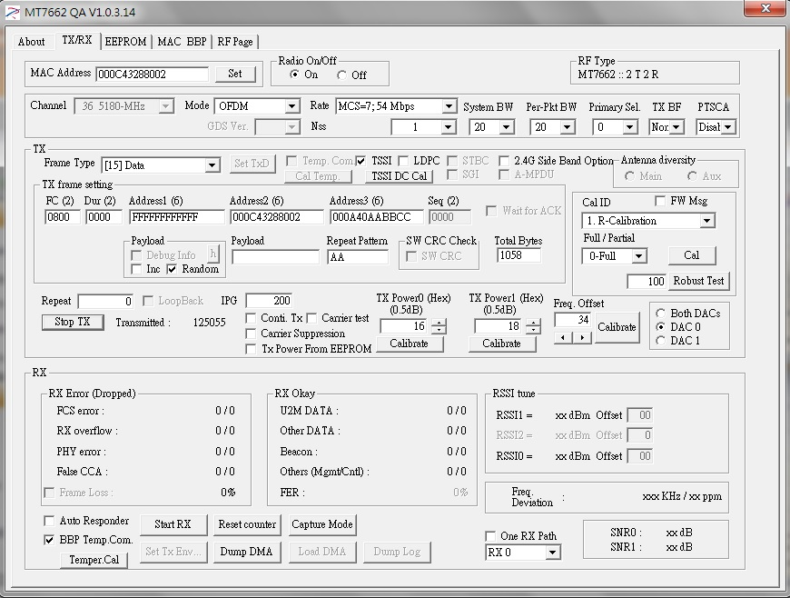
QA Tool process for 5G
1
2
3
4
5
6
7
8
1.Select channel
2. Modulation
3. Rate
4. Bandwidth
5. 0 is continuous packet
6. Tx power index
7. Select ANT port

Slide 9
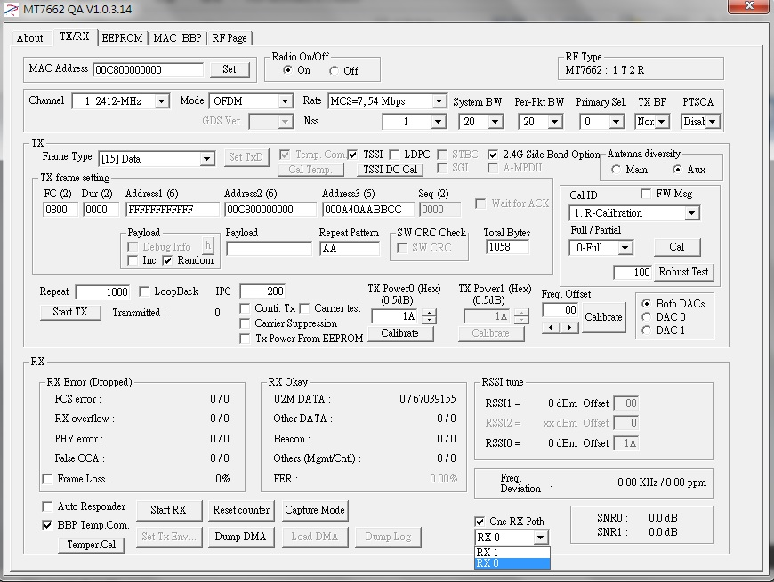
QA Tool process for 5G
1
2
3
4
1.Select channel
2. Modulation
3. Rate
4. Bandwidth
5. Select ANT port
6
5

